Slide 1

Agile Modeling and Prototyping
6
Systems Analysis and Design, 8e
Kendall & Kendall

Slide 2
Learning Objectives
Understand the roots of agile modeling in prototyping and the four main types of prototyping.
Be able to use prototyping for human information requirements gathering.
Understand the concept of RAD for use in human information requirements gathering and interface design.
Understand agile modeling and the core practices that differentiate it from other development methodologies.
Learn the importance of values critical to agile modeling.
Understand how to improve efficiency for users who are knowledge workers using either structured methods or agile modeling.

Slide 3
Agile Modeling, but First Prototyping
Agile modeling is a collection of innovative, user-centered approaches to systems development.
Prototyping is an information-gathering technique useful in seeking user reactions, suggestions, innovations, and revision plans.
Notes:
Prototyping and RAD (rapid application development) can also be used as an alternative method to SDLC.

Slide 4
Major Topics
Prototyping
Rapid application development (RAD)
Agile modeling

Slide 5
Prototyping
Patched-up
Nonoperational
First-of-a-series
Selected features
Notes:
Information gathered in the prototyping phase allows the analyst to set priorities and redirect plans inexpensively, with a minimum of disruption.

Slide 6
Patched-Up Prototype
A system that works but is patched up or patched together.
A working model that has all the features but is inefficient.
Users can interact with the system.
Retrieval and storage of information may be inefficient.
Notes:
In engineering this approach is referred to as breadboarding.
Users can interact with the system – getting accustomed to the interface and types of output available.
Retrieval and Storage of information may be inefficient – programs were written rapidly with the objective of being workable rather than efficient.

Slide 7
Nonoperational Scale Models
A nonworking scale mode that is set up to test certain aspects of the design.
A nonworking scale model of an information system might be produced when the coding required by the application is too expensive to prototype but when a useful idea of the system can be gained through prototyping of the input and output only.
Notes:
A nonworking scale model of an information system –
processing because of undue cost and time, would not be prototyped.
users can make decisions based on their use of prototyped input and output.

Slide 8
First-of-a-Series Prototype
Creating a pilot
Prototype is completely operational
Useful when many installations of the same information system are planned
A full-scale prototype is installed in one or two locations first, and if successful, duplicates are installed at all locations based on customer usage patterns and other key factors.
Notes:
Pilot – a first full-scale model of a system.
Creation of a working model is one of the types of prototyping done with RAD.

Slide 9
Selected Features Prototype
Building an operational model that includes some, but not all, of the features that the final system will have
Some, but not all, essential features are included
Built in modules
Part of the actual system
Notes:
Some, but not all, essential features are included – a menu on a screen that lists six features may only have three available.
Built in modules – if the features that are prototyped are evaluated by users as successful, they can be incorporated into the larger, final system without undertaking immense work in interfacing.
Part of the actual system – not just a mock-up.

Slide 10
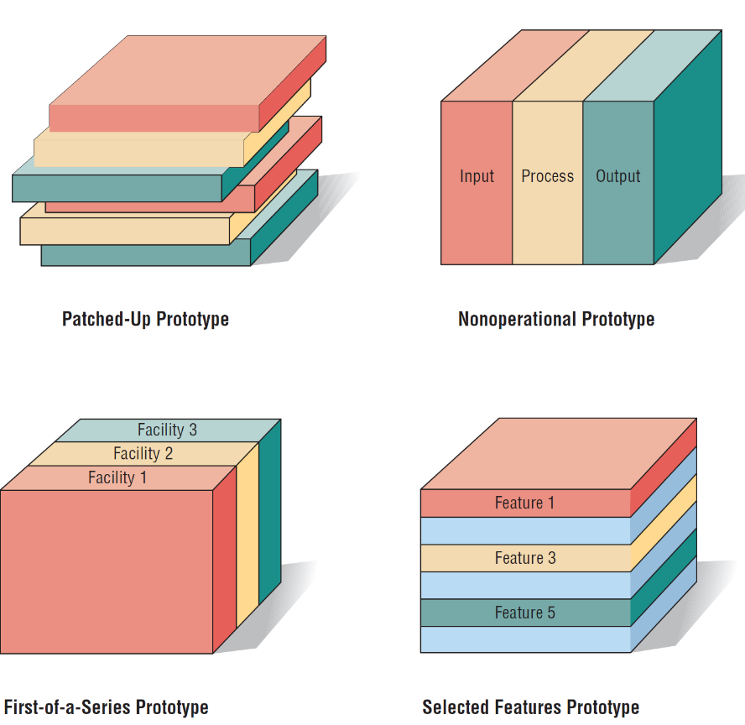
Four Kinds of Prototypes
Clockwise, Starting from the Upper Left
(Figure 6.1)

Slide 11
Prototyping as an Alternative to the Systems Life Cycle
Two main problems with the SDLC
  Extended time required to go through the development life cycle
  User requirements change over time
Rather than using prototyping to replace the SDLC use prototyping as a part of the SDLC
Notes:
SDLC – a logical, systematic approach to follow in the development of information systems.
Rather than using prototyping to replace the SDLC use prototyping as a part of the SDLC –
Advantages –
effectively shortens the time between ascertainment of human information requirements and delivery of a workable system.
overcomes some of the problems of accurately identifying user information requirements.
Disadvantages –
prematurely shaping a system before the problem or opportunity being addressed is thoroughly understood.
may result in producing a system that is accepted by specific groups of users but that is inadequate for overall system needs.

Slide 12
Guidelines for Developing a Prototype
Work in manageable modules.
Build the prototype rapidly.
Modify the prototype in successive iterations.
Stress the user interface.
Notes:
Prototyping is a superb way to elicit feedback about the proposed system and about how readily it is fulfilling the information needs of its users.
The first step of prototyping is to estimate the costs involved in building a module of the system.
Work in manageable modules - a manageable module is one that allows users to interact with its key features but can be built separately from other system modules.
Build the prototype rapidly - putting together an operational prototype both rapidly and early in the SDLC allows the analyst to gain valuable insight into how the remainder of the project should go.
Modify the prototype - creating it in modules that are not highly interdependent.
Stress the user interface - for many users the interface is the system.

Slide 13
Disadvantages of Prototyping
It can be difficult to manage prototyping as a project in the larger systems effort.
Users and analysts may adopt a prototype as a completed system.
Notes:
users and analysts may adopt a prototype as a completed system - when it is in fact inadequate and was never intended to serve as a finished system.

Slide 14
Advantages of Prototyping
Potential for changing the system early in its development
Opportunity to stop development on a system that is not working
Possibility of developing a system that more closely addresses users’ needs and expectations
Notes:
Successful prototyping depends on early and frequent user feedback, which analysts can use to modify the system and make it more responsive to actual needs.

Slide 15
Prototyping Using COTS Software
Sometimes the quickest way to prototype is through the modular installation of COTS software.
Some COTS software is elaborate and expensive, but highly useful.
Notes:
Example –
Catholic University’s use of the ERP COTS software package called PeopleSoft, which is handling many of its Web-based functions.

Slide 16
Users’ Role in Prototyping
Honest involvement
  Experimenting with the prototype
  Giving open reactions to the prototype
  Suggesting additions to or deletions from the prototype
Notes:
Without user involvement there is little reason to prototype.
To facilitate the prototyping process, the analyst must clearly communicate the purposes of prototyping to users, along with the idea that prototyping is valuable only when users are meaningfully involved.

Slide 17
Rapid Application Development (RAD)
An object-oriented approach to systems development that includes a method of development as well as software tools
Notes:
Can be thought of as a specific implementation of prototyping.

Slide 18
RAD Phases
Requirements planning
RAD design workshop
Implementation

Slide 19
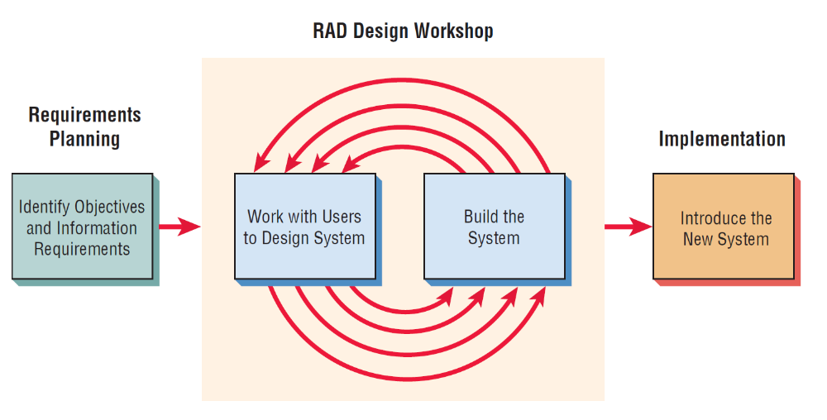
The RAD Design Workshop Is the Heart of the Interactive Development Process (Figure 6.4)
Notes:
Notice that RAD involves users in each part of the development effort, with intense participation in the business part of the design.

Slide 20
Requirements Planning Phase
Users and analysts meet to identify objectives of the application or system.
Orientation is toward solving business problems.
Notes:
Users and analysts meet to identify objectives of the application or system – and to identify information requirements arising from those objectives.
Orientation is toward solving business problems – the focus will always remain on reaching business goals.

Slide 21
RAD Design Workshop
Design and refine phase.
Use group decision support systems room if available.
Users respond to actual working prototypes.
Analysts refine designed modules based on user responses.
Notes:
Design and refine phase – can best be characterized as a workshop.
The workshop format is very exciting and stimulating, and if experienced users and analysts are present, there is no question that this creative endeavor can propel development forward at an accelerated rate.

Slide 22
Implementation Phase
As the systems are built and refined, the new systems or part of systems are tested and then introduced to the organization.
When creating new systems, there is no need to run old systems in parallel.
Notes:
When creating new systems, there is no need to run old systems in parallel - there is no old system, there is often no need to (and no real way to) run the old and new systems in parallel before implementation.

Slide 23
Comparing RAD to the SDLC
RAD software tools are used to generate screens and exhibit the overall flow of the running of the application.
RAD users are signing off on a visual model representation.
RAD implementation is less stressful because users have helped to design the business aspects of the system.
Notes:
The ultimate purpose of RAD is to shorten the SDLC and in this way respond more rapidly to dynamic information requirements of organizations.

Slide 24
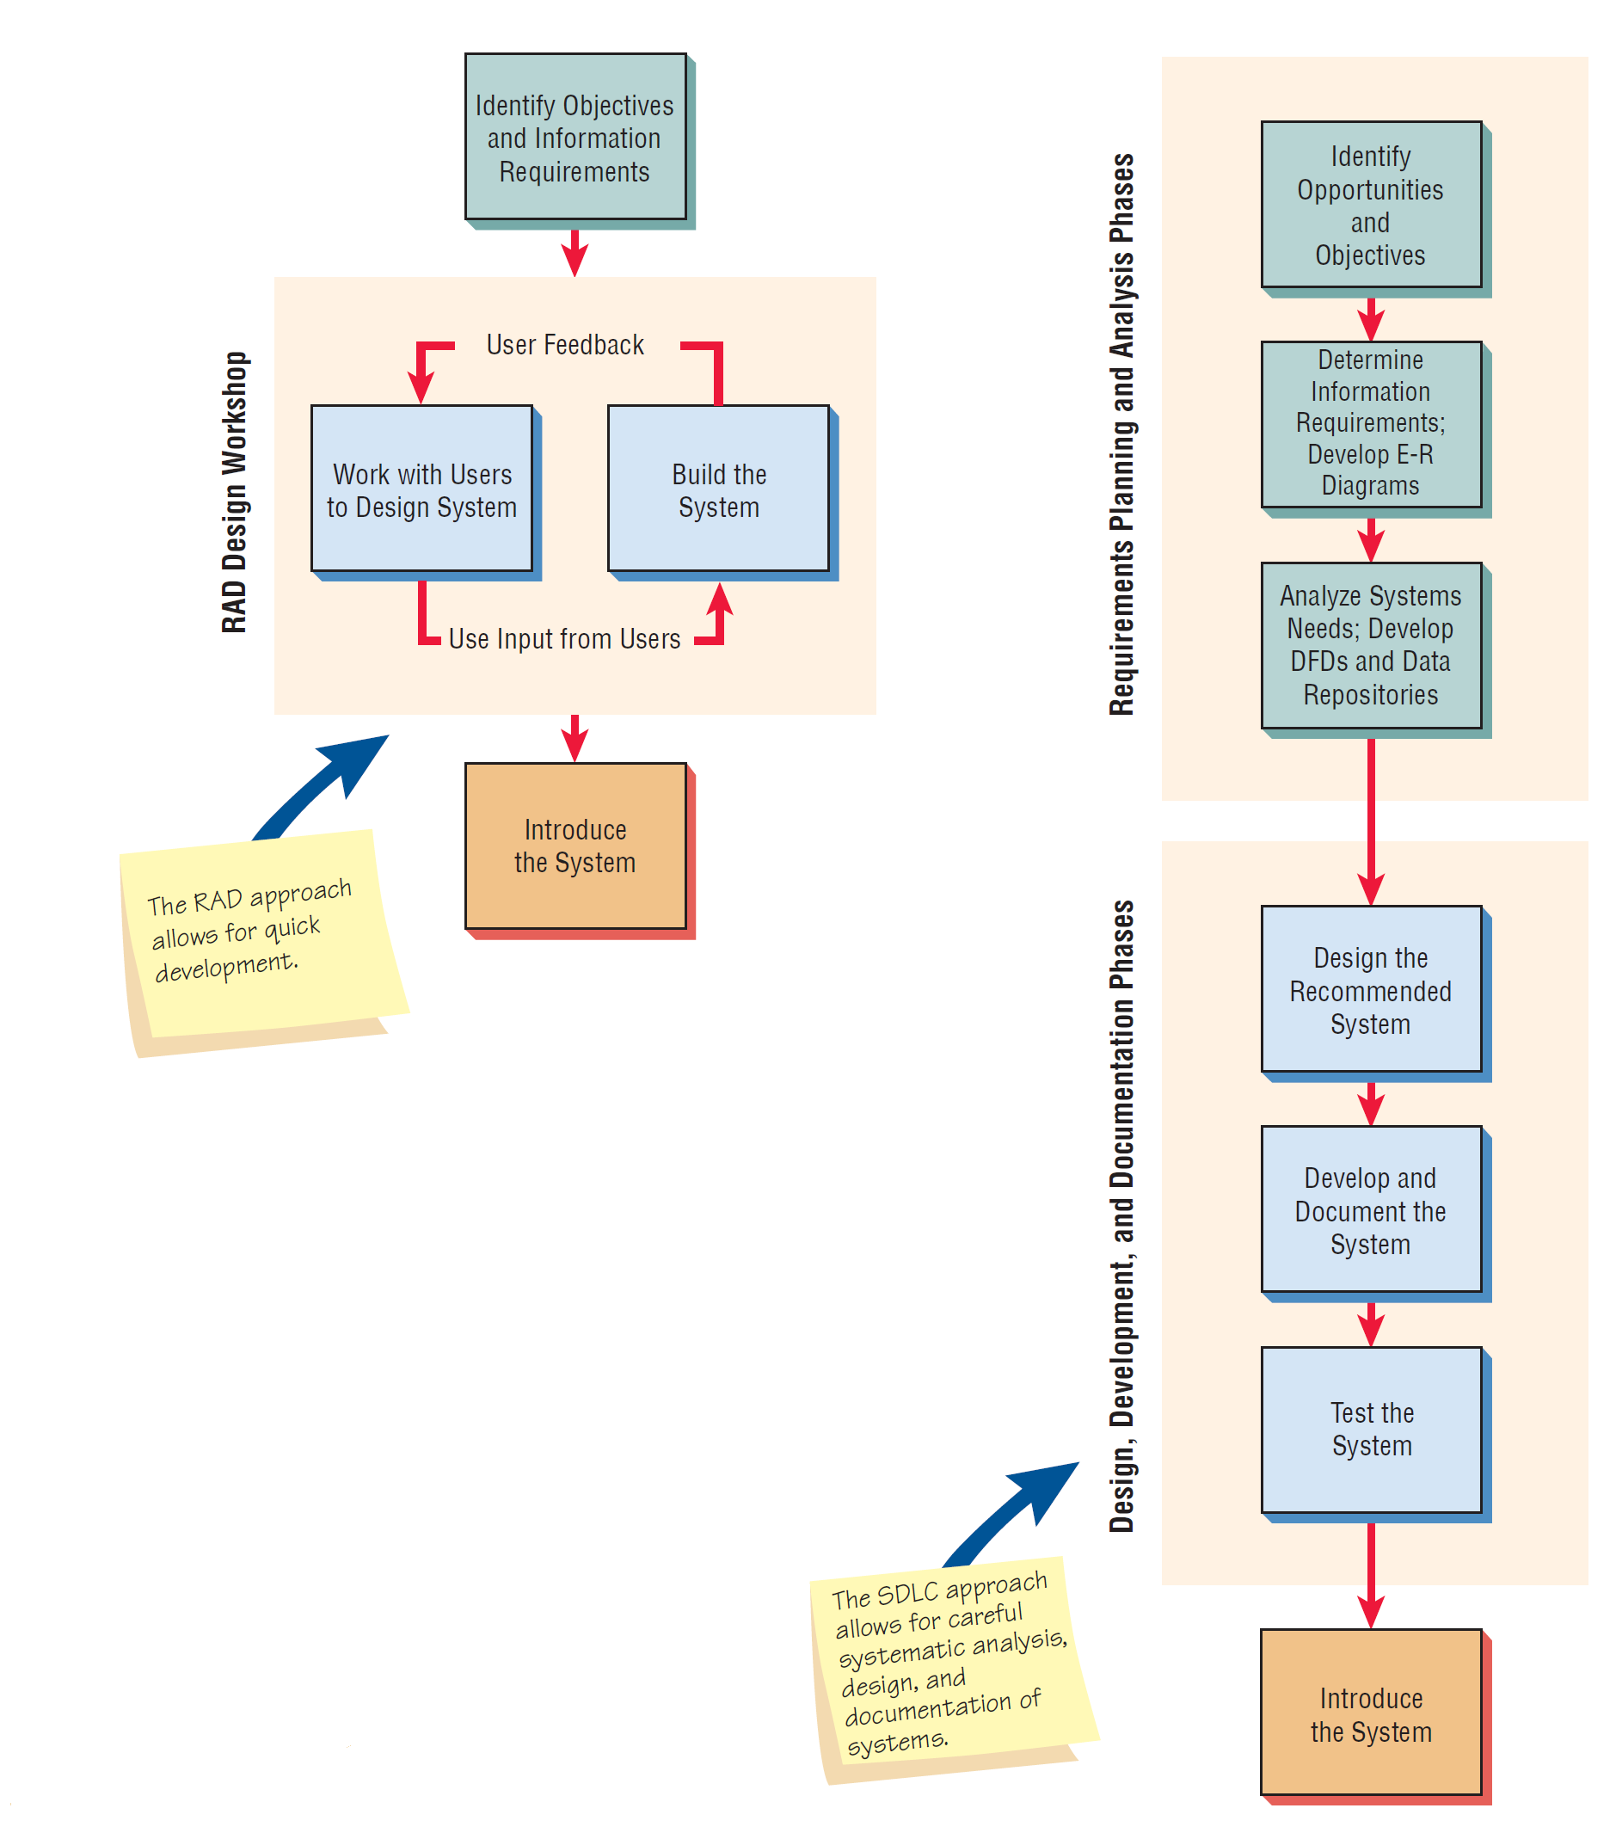
The RAD Design Workshop and the SDLC Approach Compared (Figure 6.5)

Slide 25
When to Use RAD
The team includes programmers and analysts who are experienced with it.
There are pressing reasons for speeding up application development.
The project involves a novel ecommerce application and needs quick results.
Users are sophisticated and highly engaged with the goals of the company.
Notes:
As an analyst, you want to learn as many approaches and tools as possible to facilitate getting your work done in the most appropriate way.

Slide 26
Disadvantages of RAD
Trying to hurry the project too much
Lack of documentation
Notes:
Example – building a storage shed.

Slide 27
Agile Modeling
Agile methods are a collection of innovative, user-centered approaches to systems development.

Slide 28
Values and Principles of Agile Modeling
Communication
Simplicity
Feedback
Courage
Notes:
Agile modelers possess the self-confidence to allow their customers to question, critique, and sometimes complain about the system under development. Analysts learn from their customers, who have been in business a long time.

Slide 29
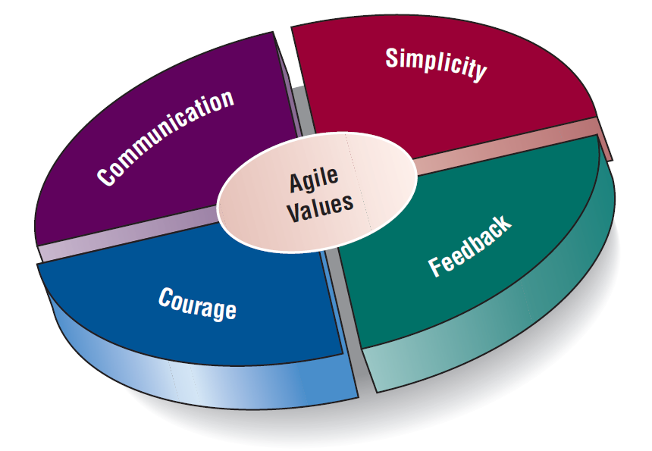
Values Are Crucial to the Agile Approach (Figure 6.6)

Slide 30
The Basic Principles of Agile Modeling
Satisfy the customer through delivery of working software.
Embrace change, even if introduced late in development.
Continue to deliver functioning software incrementally and frequently.
Encourage customers and analysts to work together daily.
Trust motivated individuals to get the job done.
Notes:
Providing rapid feedback - in order for humans or the system to make a connection between a stimulus and reaction, the feedback must occur at a reasonable interval.
Assuming simplicity - over 90 percent of problems can be solved with utter simplicity.
Changing incrementally - you are constantly making the smallest change possible that still results in a difference in the development effort.
Embracing change - we want to keep all of our options open, but we want to be able to simultaneously solve whatever presents the biggest obstacle.
Encouraging quality work - all participants want to do quality work.

Slide 31
The Basic Principles of Agile Modeling (continued)
Promote face-to-face conversation.
Concentrate on getting software to work.
Encourage continuous, regular, and sustainable development.
Adopt agility with attention to mindful design.
Support self-organizing teams.
Notes:
Providing rapid feedback - in order for humans or the system to make a connection between a stimulus and reaction, the feedback must occur at a reasonable interval.
Assuming simplicity - over 90 percent of problems can be solved with utter simplicity.
Changing incrementally - you are constantly making the smallest change possible that still results in a difference in the development effort.
Embracing change - we want to keep all of our options open, but we want to be able to simultaneously solve whatever presents the biggest obstacle.
Encouraging quality work - all participants want to do quality work.

Slide 32
The Basic Principles of Agile Modeling (continued)
Provide rapid feedback.
Encourage quality.
Review and adjust behavior occasionally.
Adopt simplicity.
Notes:
Providing rapid feedback - in order for humans or the system to make a connection between a stimulus and reaction, the feedback must occur at a reasonable interval.
Assuming simplicity - over 90 percent of problems can be solved with utter simplicity.
Changing incrementally - you are constantly making the smallest change possible that still results in a difference in the development effort.
Embracing change - we want to keep all of our options open, but we want to be able to simultaneously solve whatever presents the biggest obstacle.
Encouraging quality work - all participants want to do quality work.

Slide 33
Activities, Resources, and Practices of Agile Modeling
Coding
Testing
Listening
Designing
Notes:
The agile analyst needs to identify the amount of effort that will go into each activity and balance that with the resources needed to complete the project.
Coding - the most valuable thing that we receive from code is “learning.”
Testing - the agile approach views automated tests as critical.
Listening - in the agile approach, listening is done in the extreme.
Designing - a way of creating a structure to organize all of the logic in the system.

Slide 34
Four Resource Control Variables of Agile Modeling
Time
Cost
Quality
Scope
Notes:
When these four control variables are properly included in the planning, there is a state of balance between the resources and the activities needed to complete the project.

Slide 35
Four Core Agile Practices
Short releases
40-hour work week
Onsite customer
Pair programming
Notes:
Short releases - the development team compresses the time between releases of their product.
40-hour work week - agile development teams purposely endorse
a cultural core practice in which the team works intensely together during a typical 40-hour work week.
Onsite customer - a user who is an expert in the business aspect of the systems development work is onsite during the development process.
Pair programming - you work with another programmer of your own choosing.

Slide 36
The Agile Development Process
Listen for user stories.
Draw a logical workflow model.
Create new user stories based on the logical model.
Develop some display prototypes.
Create a physical data model using feedback from the prototypes and logical workflow diagrams.

Slide 37
Writing User Stories
Spoken interaction between developers and users
Seeking first and foremost to identify valuable business user requirements
The goal is prevention of misunderstandings or misinterpretations of user requirements.
Notes:
User stories serve as reminders to the developers that they must hold conversations devoted to those requirements.

Slide 38
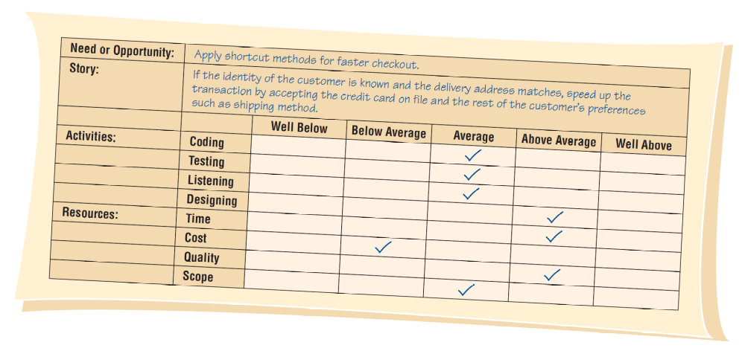
User Stories Can Be Recorded on Cards: The User Story Should Be Brief Enough for an Analyst to Determine What Systems Features Are Needed (Figure 6.8)
Notes:
In this example from the online merchant, the analyst indicates that the designing activity will take above-average effort, and the time and quality resources are required to rise above average.

Slide 39
Scrum
Begin the project with a high-level plan that can be changed on the fly.
Success of the project is most important.
Individual success is secondary.
Project leader has some (not much) influence on the detail.
Systems team works within a strict time frame.

Slide 40
Scrum
Product backlog
Sprint backlog
Sprint
Daily scrum
Demo
Notes:
Scrum is a high-intensity methodology. It is just one of the approaches that adopts the philosophy of agile modeling.
Product backlog - in which a list is derived from product specifications.
Sprint backlog - a dynamically changing list of tasks to be completed in the next sprint.
Sprint - a 30-day period in which the development team transforms the backlog into software that can be demonstrated.
Daily scrum - a brief meeting in which communication is the number-one rule.
Demo - working software that can be demonstrated to the customer.

Slide 41
Lessons Learned from Agile Modeling
Short releases allow the system to evolve.
Pair programming enhances the overall quality.
Onsite customers are mutually beneficial to the business and the agile development team.
Notes:
Short releases allow the system to evolve - through the use of short releases, the development team compresses the time between releases of their product, improving the product later as the dynamic situation demands.
Pair programming enhances overall quality - fosters good communication, identifying with the customer, focusing on the most valuable aspects of the project first, testing all code as it is developed, and integrating the new code after it successfully passes its tests.
Onsite customers are mutually beneficial to the business and the agile development team - customers serve as a ready reference and reality check, and the focus of the system design will always be maintained via their presence.

Slide 42
Lessons Learned from Agile Modeling (Continued)
The 40-hour work week improves worker effectiveness.
Balanced resources and activities support project goals.
Agile values are crucial to success.
Notes:
The 40-hour work week improves worker effectiveness - even the hardest-hitting developers are susceptible to errors and burnout if they work too hard for too long a period.
Balanced resources and activities support project goals - the resource control variables of time, cost, quality, and scope need to be properly balanced with the activities of coding, designing, testing, and listening.
Agile values are crucial to success - it is essential to the overall success of the project that analysts wholeheartedly embrace the values of communication, simplicity, feedback, and courage in all of the work that they do.

Slide 43
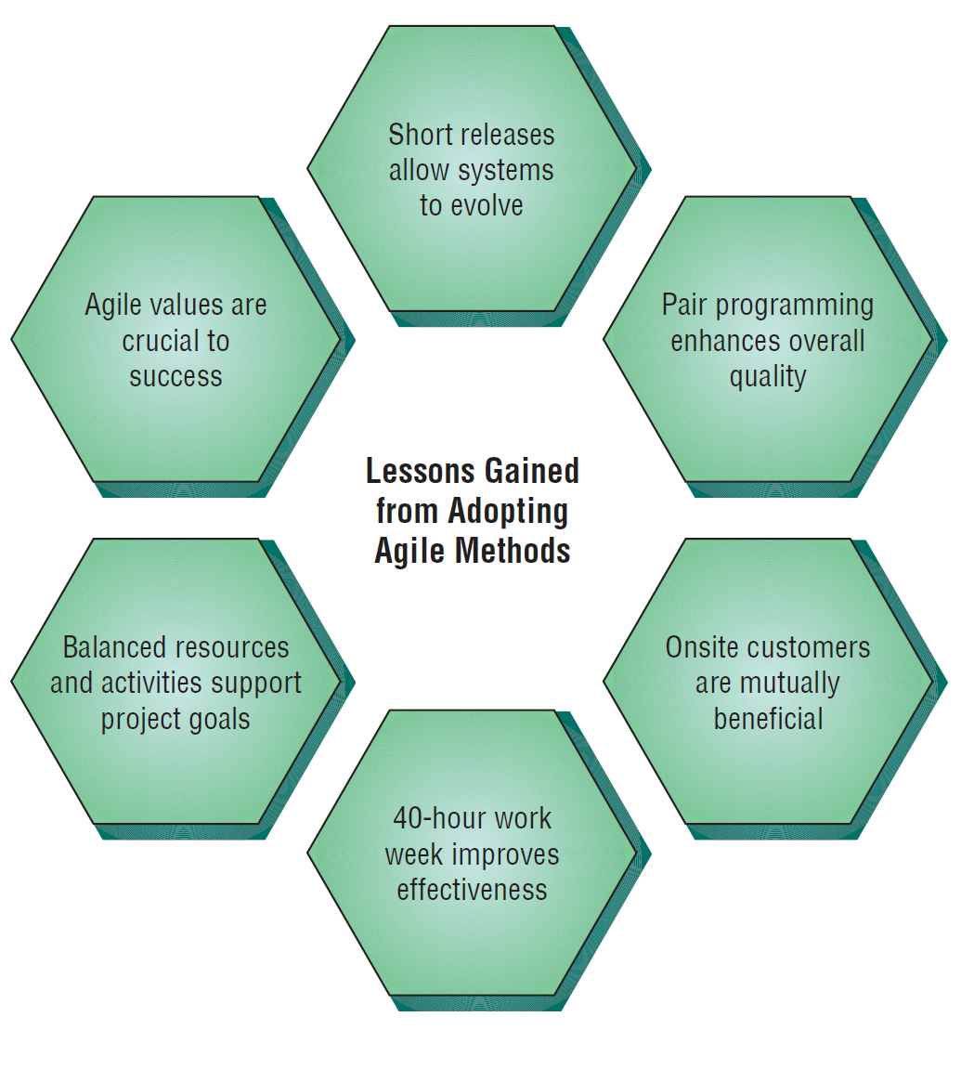
There Are Six Vital Lessons that Can Be Drawn from the Agile Approach to Systems (Figure 6.9)

Slide 44
Comparing Agile Modeling and Structured Methods
Improving the efficiency of systems development
Risks inherent in organizational innovation
Notes:
Efficiency - seven strategies that can improve the efficiency of knowledge work.
Risks – when is the appropriate time to upgrade human skills, adopt new organizational processes, and institute internal change.

Slide 45
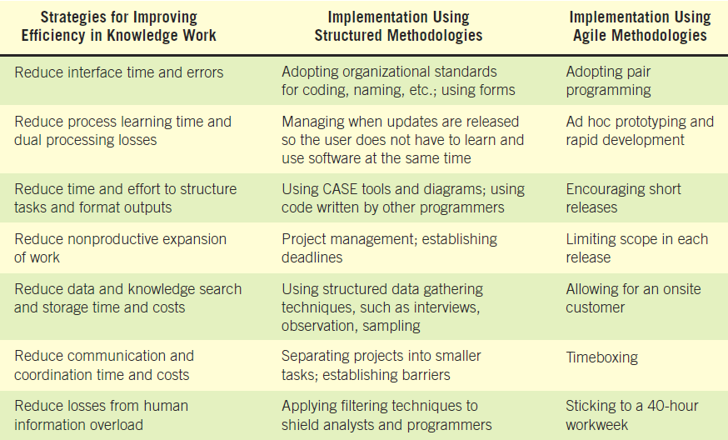
Strategies for Improving Efficiency Can Be Implemented Using Two Different Development Approaches (Figure 6.10)

Slide 46
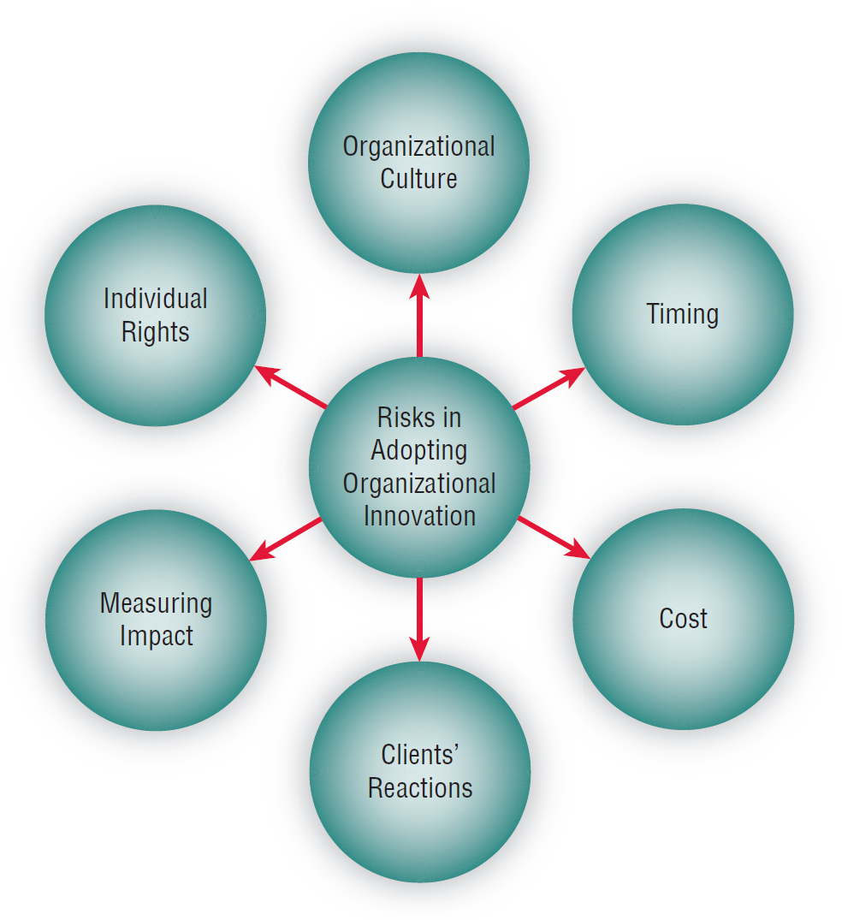
Adopting New Information Systems Involves Balancing Several Risks (Figure 6.11)
Notes:
In consultation with users, analysts must consider the risks that organizations face when adopting new methodologies.
Shows many of the variables that need to be considered when assessing the risk of adopting organizational innovation.

Slide 47
Risks When Adopting New Information Systems
Fit of development team culture
Best time to innovate
Training cost for analysts and programmers
Client’s reaction to new methodology
Impact of agile methodologies
Programmers/Analysts individual rights

Slide 48
Summary
Prototyping
  Patched-up system
  Nonoperational
  First-of-a-series
  Selected-features
Prototype development guidelines
Prototype disadvantages

Slide 49
Summary (Continued)
Prototype advantages
Users’ role in prototyping
Agile modeling
Five values of the agile approach
Principles of agile development
Agile activities
Agile resources

Slide 50
Summary (Continued)
Core practices of the agile approach
Stages in the agile development process
User stories
Agile lessons
Scrum methodology
Dangers to adopting innovative approaches

Slide 51

All rights reserved. No part of this publication may be reproduced, stored in a retrieval system, or transmitted, in any form or by any means, electronic, mechanical, photocopying, recording, or otherwise, without the prior written permission of the publisher. Printed in the United States of America.
Copyright © 2011 Pearson Education, Inc.
Publishing as Prentice Hall

